Slide 1


GOTECH Team 2 Demo
ANDREW WANG
QUINN STANK
KAREEM NAGUIB

Slide 2
AGENDA
Introduction
Technical Areas
Overall Strategy
Technical Area 1: Cross-Validate Open Source Reef DB
Data sources: Allen Coral Atlas. Florida Bleach Watch. NOAA CoastWatch Degree Heating Week (DHW). Giovanni. World Conservation Monitoring Centre (WCMC). Reefbase
Preliminary Analysis
Data Fusion
Dataset Breakdown
Technical Area 2: Calipso Data
Data Fusion Workflow
Fused Dataset
Exploratory Data Analysis
Technical Area 3: Correlation Analysis
Approach
Vitality Data
Classifier Results
Technical Area 4: Inference
Approach and Classifier Results
Failed Classifiers
Data Visualization and Inference
Takeaways and Future work

Slide 3
Introduction: Technical Areas
Technical Area 1
Technical Area 2
Technical Area 3
Cross-Validate Open Source Reef Databases
Time and Geo-Align with Corresponding CALIPSO data
Correlate Calipso data with state of Coral in observed global regions
Technical Area 4
Interpret Trends in known global region using CALIPSO data

Slide 4
Introduction: Technical Areas
Technical Area | Task | Challenges
1. Cross-Validate Open Source Reef Databases | Data collection for coral reef locations and health. Identify at least four coral databases to combine into a single dataset. | High effort spent just searching for surveys and reef locations. Data processing consumed high resources
2. Time and Geo-Align with Corresponding CALIPSO data | Develop API clients for the CALIPSO database to acquire necessary data. Fuse CALIPSO dataset with ground truth data. | High dimensional, sparse datasets.
3. Correlate Calipso data with state of Coral in observed global regions | Predict the existence of coral in an observed region Use inference to confirm that we can predict properties of vitality | Determining appropriate rules and thresholds for creating labels. Class imbalances
4. Interpret Trends in known global region using CALIPSO data | Design and develop experiments to demonstrate the predictive accuracy of the developed models. | Inherent issues with mandatory CALIPSO dataset

Slide 5
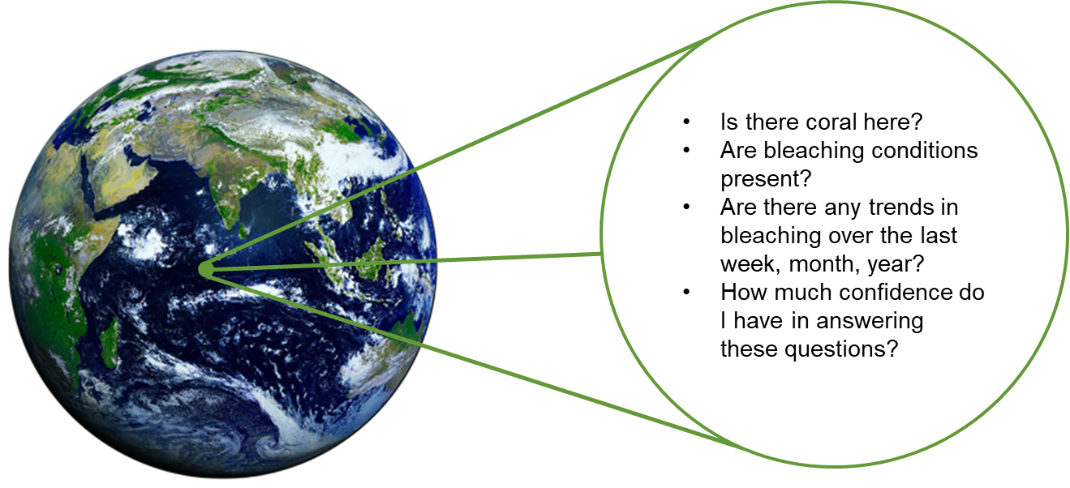
Introduction: Basic Goals

Slide 6
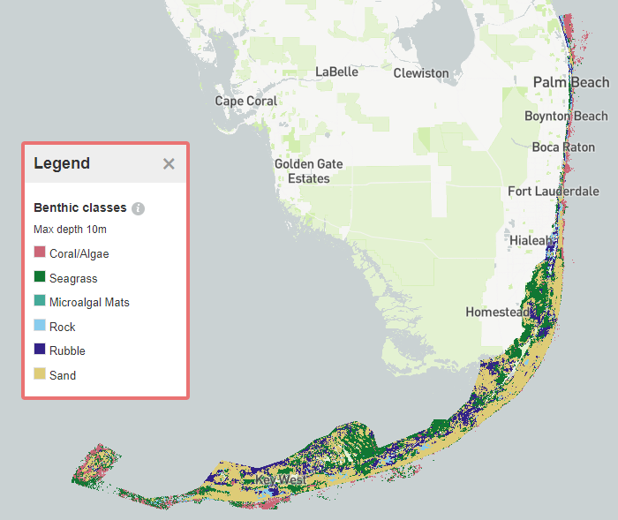
Introduction: Region of Focus
Florida use-case:
One of few locations with detailed bleaching survey reports containing GIS information and dates ranging from 2014-2020.
Total of 2210 reports submitted with 1318 bleaching events and 892 non-bleaching events.
Unique locations: 1690
Over 2M unique locations from Allen Coral Atlas database.

Slide 7
Technical Area 1: Cross-Validate Open-Source Reef Databases
Goal: Identify at least four coral databases and combine into a single dataset for ground truth labels.
Data | Source | Data Collection Method | Notes
Reef Locations - Classification Labels | Allen Coral Atlas | direct download from website | Scalable, labels, accuracy 60-90% classification
 | World Conservation Monitoring Centre (WCMC) | direct download from website | Scalable, labels, accuracy is unknown
 | ReefBase | direct download from website | Approximate locations of coral reefs
Reef Vitality - Coral Reef health | Florida Bleach Watch Report | direct download from website | Comprehensive surveys
 | NOAA Coastwatch Coral Reef Watch Bleaching Alert | API | Satellite coral bleaching heat stress monitoring, 5 km coverage area
 | NASA Giovanni | API | PAR, Chlorophyll, organic/inorganic particulates, weekly temporal frequency, 5 km coverage

Slide 8
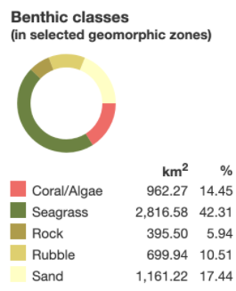
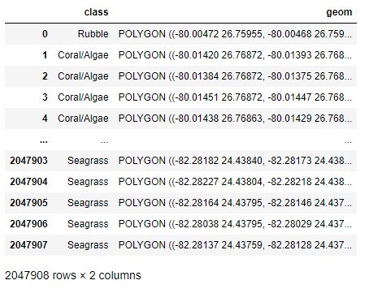
Allen Coral Atlas
Data: Reef and Bleaching Locations
Available Parameters:
label, polygon for label shapes
Method: .geojson through Allen Coral Atlas website.
Available Date Range: N/A
Website: https://allencoralatlas.org/
Description:
This dataset represents a comprehensive lexicon for reef locations worldwide. The only issue is that it does not have a solo "reef" class in these labels. Instead, coral reef and algae are combined into 1 label which requires data engineering to select only reef locations.
Pros | Cons
Easy to download Global geojson files with polygon variables for each label | No separation between Coral and Algae classes Reported confidence between 60-90%

Slide 9
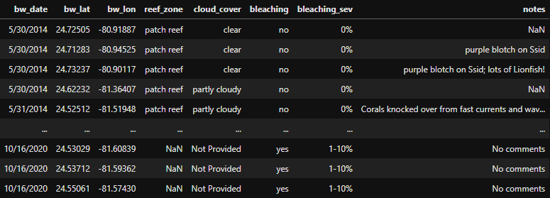
Florida Bleach Watch
Data: Reef and Bleaching Locations
Available Parameters:
Lat/Lon, date, bleaching, % bleached, depth
Disease info provided but only a few data points available.
Method: .csv through Florida Bleach Watch Report website.
Available Date Range: yearly from roughly May to October
Website: https://floridadep.gov/rcp/coral/content/bleachwatch
Description:
Florida state database containing Information from NOAA's remote sensing and Integrated Coral Observing Network (ICON) in-situ environmental monitoring analysis and "BleachWatch" volunteer field observations. Provides a comprehensive overview of "current conditions" throughout the region.
Pros | Cons
Detailed and comprehensive surveys on coral health Data comes from “boots-on-the-ground” observations | Relatively small number of observations Data is sometimes unreliable Consistency in data is unreliable due to large differences in coral knowledge for collectors Reports are limited to only the state of Florida
Notes:
Contributions by citizen scientists

Slide 10
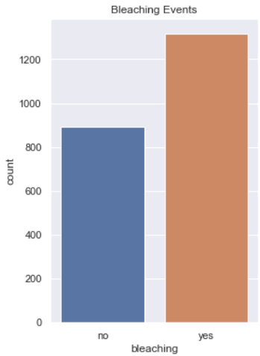
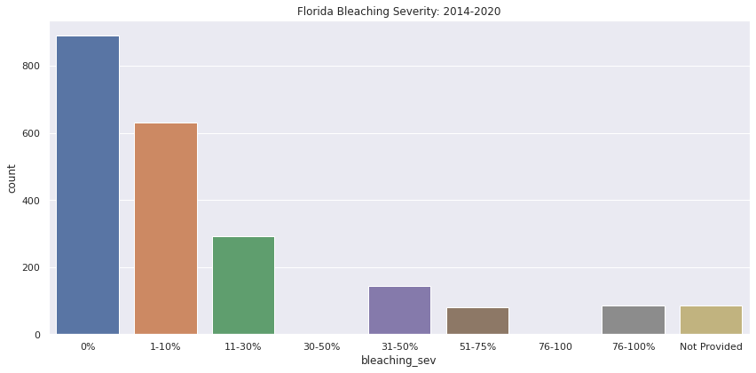
Florida Bleach Watch
Notes:
kareem will add some basic info

Slide 11
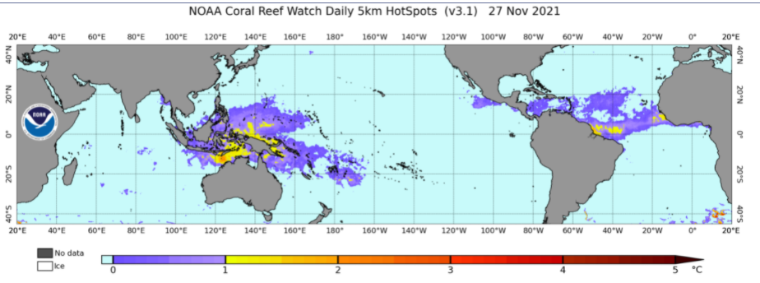
NOAA CoastWatch (DHW)
Data: DHW, Chloroform, SST, and PAR
Method: NOAA CoastWatch using API
Available Date Range: 04/1985-11/2021
Website: https://coastwatch.pfeg.noaa.gov/erddap/griddap/NOAA_DHW.html
Description:
CoastWatch has utilized remote sensing, modeled and in situ data to observe, predict, and con worldwide coral reef environments. CoastWatch monitors coral conditions to provide a global warning system of coral reef health. Particularly, the CoastWatch dataset provides metrics which can be used to determine if bleaching occurred when coral locations are known
Pros | Cons
Easily accessible, worldwide data Considered a highly accurate data source by Coral Vita experts Longest running coral bleaching data implement by the team | Bleaching reports are from modeling and not actual observations Reported bleaching is based off environmental conditions and does not necessarily correlate to actual coral locations

Slide 12
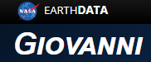
NASA Giovanni
Data: PAR, inorganic particulate, organic particulate, and chlorophyll a
Method: .netcdf through Giovanni website
Available Date Range: 07/2002-06/2021
Website: https://giovanni.gsfc.nasa.gov/giovanni/#service=HvLt&starttime=&endtime=
Description:
The Giovanni dataset contains netCDF files sampled every 8 days from June 2006 to June 2002. All measurements are recorded from the MODIS (or Moderate Resolution Imaging Spectroradiometer) Aqua satellite. A NASA Earthdata account is required to access the data
Pros | Cons
Worldwide data observations High temporal frequency (8-days) enables easier matching with CALIPSO data Multiple different variables available High confidence in reported measurements | 4km resolution does not provide sufficient distance accuracy or confidence Data acquisition to 365 time-steps at a time which vastly increases the time required to acquire data for large periods of time

Slide 13
World Conservation Monitoring Centre (WCMC)
Data: Different kind of reefs’ locations
Method: .zip through WCMC website.
Available Date Range: 01/1999-12/2005
Website: https://data.unep-wcmc.org/datasets/1
Description:
WCMC dataset shows the global distribution of coral reefs in tropical and subtropical regions. It is used as a foundation baseline map for coral reef locations. The dataset was compiled from a number of sources by UNEP World Conservation Monitoring Centre (UNEP-WCMC) and the WorldFish Centre, with WRI (World Resources Institute) and TNC (The Nature Conservancy). Data sources include the Millennium Coral Reef Mapping Project (IMaRS-USF and IRD 2005, IMaRS-USF 2005) and the World Atlas of Coral Reefs (Spalding et al. 2001).
Pros | Cons
Worldwide data observations Global geojson files with polygon variables for each label | 85% of database observations are from 1999-2002 ~43% of the database is unvalidated
Notes:
https://data.unep-wcmc.org/pdfs/1/WCMC_008_Global_Distribution_of_Coral_Reefs.pdf?1617121809
“Creation Methodology” section

Slide 14
Reefbase
Data: Reef and Bleaching Locations
Available Parameters:
Lat/Lon, date, bleaching severity
Method: .zip through Reefbase website
Available Date Range: N/A
Website: http://www.reefbase.org/global_database/default.aspx?section=s1
Description:
Provides location, bleaching, and health status on reefs worldwide in over 120 countries and territories. Maintains records on multiple different threats to coral reef environments to include natural, human, climate, and bleaching events. Provides info on fishery health as well as coral health.
Pros | Cons
Imagery is available online for some bleaching events Data comes from “boots-on-the-ground” observations | Obsolete Adobe Flash Player required for online tool The database appears to have a lot of holes in the data and is not a comprehensive data source

Slide 15
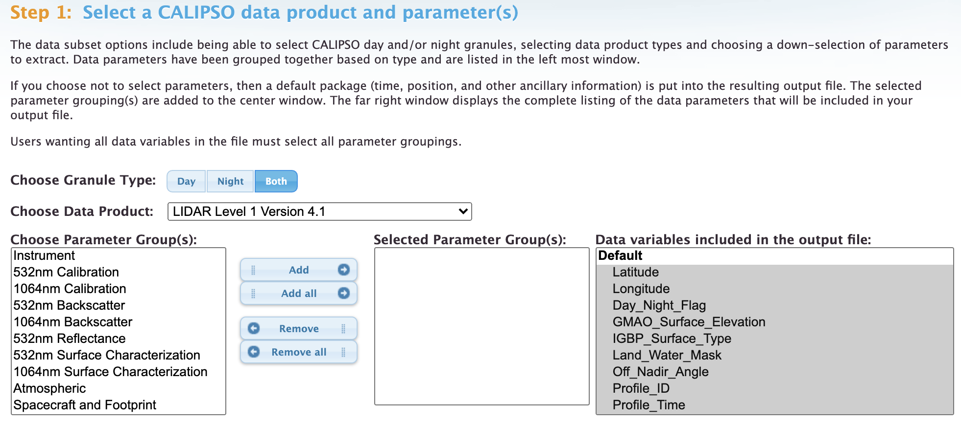
CALIPSO
Data: Reef and Bleaching Locations
Available Parameters:
Lat/Lon, date, reflectance data
Method: .hdf through CALIPSO or Earthdata website
Available Date Range: 06/2006 - 11/2021
Website: https://subset.larc.nasa.gov/calipso/ or https://search.earthdata.nasa.gov/search
Description:
Provides latitude and longitude for measurements utilizing CALIPSO CALIOP IR instrumentation. Data is rather sparse based on the ground track of the satellite, and there are errors in the data from collection. A NASA Earthdata account is required to access the dataset
Pros and Cons will be discussed in a later section

Slide 16



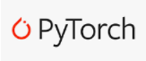







Technologies
Data Storage: PostgreSQL on Google Cloud Platform
ETL, Data Fusion, and Exploratory Data Analysis on local machine and Google Colab
Modeling on local machine and Google Colab leveraging GPU for Deep Learning Models

Slide 17
Data Pipeline Workflow
Challenges:
Performing spatial joins in using postGIS on larger datasets was time consuming →
needed to perform joins on local machine or Colab+
Inserting data into PostgreSQL database was extremely time consuming → Google Colab TPU accelerator sped up the process by ~10x!
Allen Coral
WCMC
ReefBase
Florida Bleachwatch
1. Direct Download
3. Insert data into DB
PostgreSQL
Google Colab / Local Machine
4. Query DB
NOAA Bleaching Alert
Giovanni
Calipso
1. API
Fused Dataset
5. Data Fusion
2. Data Preprocessing

Slide 18
Technical Area 2: Time-Align and Geo-Align with Corresponding CALIPSO Data Questions
Goal: Develop API clients for the CALIPSO database to acquire necessary data for neural network training and inference.
Data | Source | Description | Notes
Labels | Allen Coral Atlas | 0: “Other” 1: “Coral” | All data is joined to the closest CALIPSO point available. Allen Coral Atlas acts as the primary label source with it’s “Coral/Algae” label. These observations or correlated with the other reef location databases to separate the “Coral” from the “Algae” in the Allen Coral Atlas database.
 | World Conservation Monitoring Centre (WCMC)
 | ReefBase
 | Bleachwatch
 | NOAA Coastwatch Coral Reef Watch Bleaching Alert
Features | CALIPSO Reflectance Data | 300 CALIPSO reflectance values for differing altitudes | Several challenges in collection and instrumentation limit the viability of Reflectance data in modelling

Slide 19
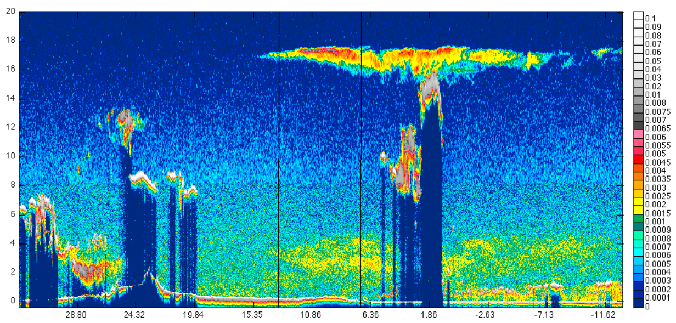
Calipso Dataset
The image on the right shows a multi-gridded averaging scheme of the calipso dataset with X-axis showing the latitude and Y-axis showing the altitude.

Slide 20
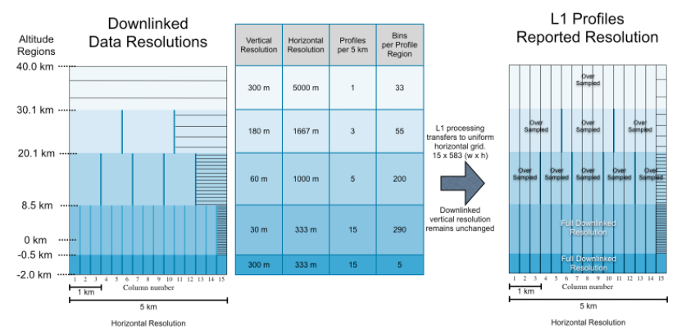
Calipso Dataset
Data was collected using altitude range from -2.0 km to 8.5 km providing 300 features for each latitude and longitude coordinate.
Each datapoint is sampled every 333 m.

Slide 21
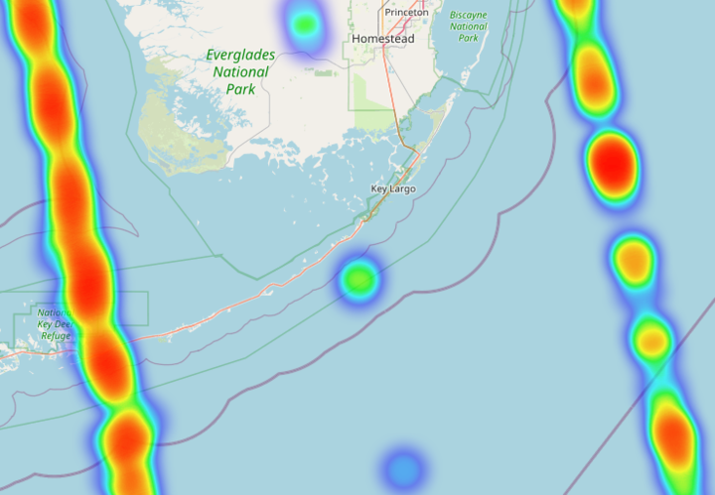
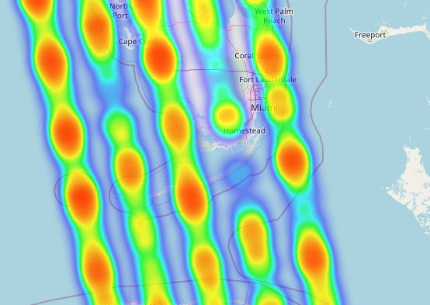
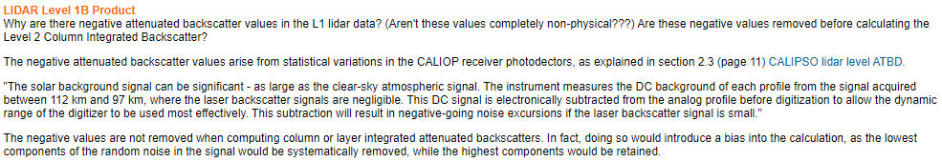
CALIPSO - Challenges
Sparse data
Negative reflectance values which can confound models

Slide 22
Technical Area 2: Fused Dataset - Methodology
Merge CALIPSO and DHW datasets
Nearest Neighbor join CALIPSO with DHW; filter for matching date
Pivot CALIPSO data so each row shows reflectance values at each depth
Merge resulting dataframe with Allen Coral Atlas and WCMC labels
Nearest Neighbor join with Allen Coral Atlas using CALIPSO point as reference
Left join resulting dataframe with Bleach Watch report
Nearest Neighbors + filter for points within 50m of Alen Coral Atlas polygon
Filter for dates within 14 days of CALIPSO reading
Pivot bleaching severity with 3 column bins with 0% (no bleaching), 1-10%, and 11-30% bleaching sev
Fill NA values of bleaching severity with 0's
Left join resulting dataframe with Reefbase (reef locations, protected sites, monitored sites)
Nearest Neighbor join points only within 100m of Allen Coral Atlas polygon
Merge with Giovanni data
Nearest Neighbor join with Giovanni data; keeping min distance
Filter for dates within 14 days of CALIPSO reading
Last Data filer
All observations are filtered to be at least within 5km of the Allen Coral Atlas class polygon
Notes:
kareem split to 4 slides

Slide 23
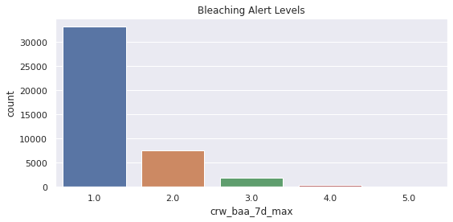
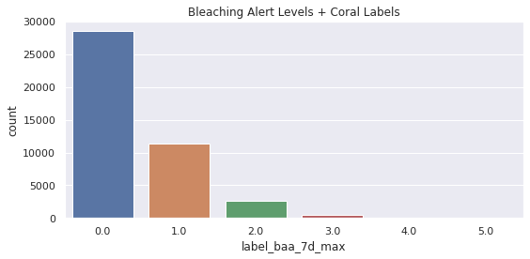
Technical Area 2: Fused Dataset - Breakdown
281MB, 337 variables, 43,162 rows of observations
Aligned by both temporal and geographic filters (all CALIPSO point values are within 5km of an Allen Coral Atlas Label)
Relevant variables include:
300 different CALIPSO resolution measurements based off altitude/depth
class - Allen Coral Atlas label
crw_baa_7d_max - max Coral Reef Watch Bleaching Alert Area score over a 7 day period
ac_distances/dhw_distances/giov_distances - calipso measurement distance from allen coral atlas/degree heating week/giovanni data
ac_confidence/dhw_confidence/giov_confidence/total_confidence - KDE probability of observing a unique distance from calipso data equal to or greater than the observation distance based off the total set of distances per dataset from calipso data
1: No Bleaching
2: Bleach Watch
3: Possible Bleaching
4: Significant Bleaching Likely
5: Severe Bleaching and Mortality Likely
0: Non Coral
1: Coral No Bleaching
2: Coral Bleach Watch
3: Coral Possible Bleaching
Labels Used in Analysis

Slide 24
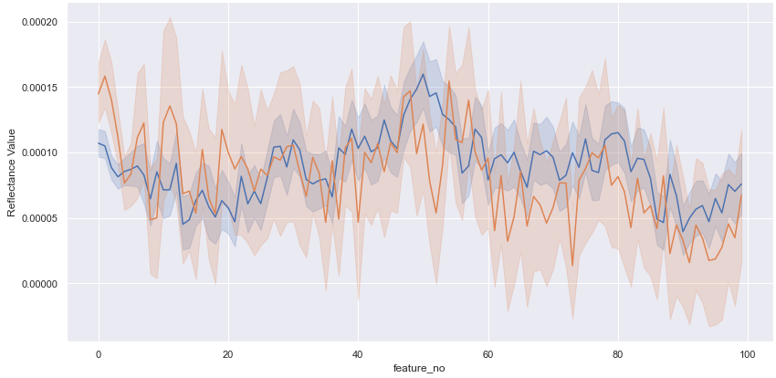
Coral vs Non-Coral Reflectance
Legend
The line plot below shows the Calipso reflectance value vs each feature which corresponds to a depth level. The shaded area represents the 95th percentile of the dataset.
Non- Coral
Coral
Calipso values overlap each other for coral vs non-coral labels, but certain features circled in red show good separation.
We expect the first few features to be more relevant since the altitude is below sea level.

Slide 25
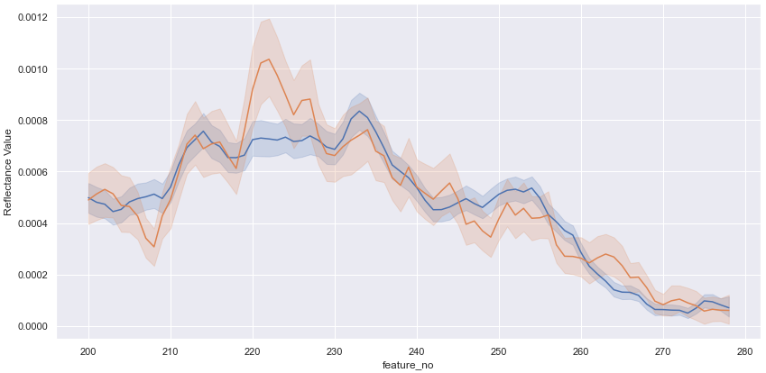
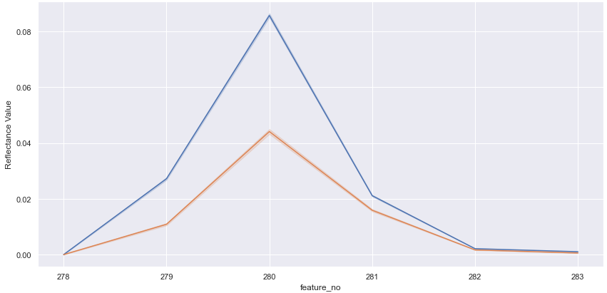
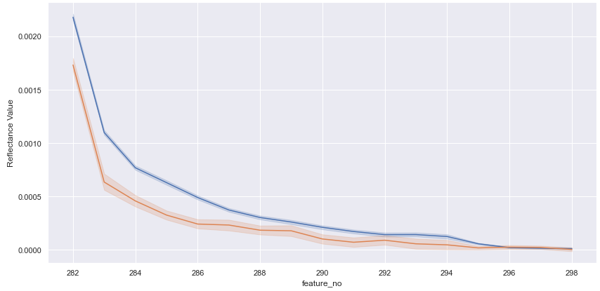
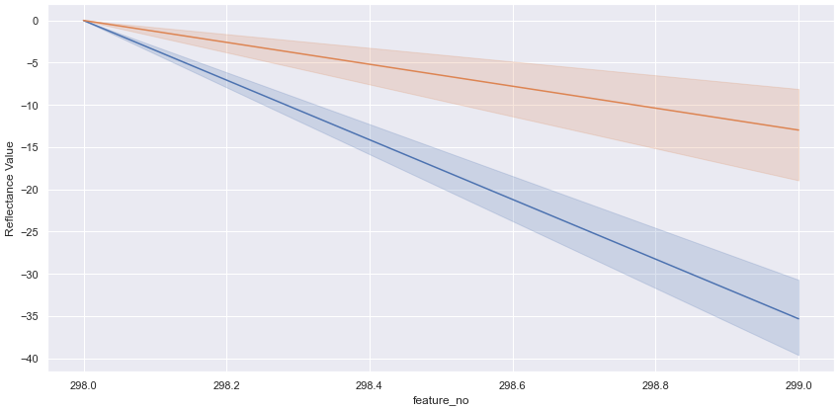
Coral vs Non-Coral Reflectance
Legend
Non- Coral
Coral
There are several unexpected cases that show significant differences in reflectance values at altitude +6 km above sea level.

Slide 26
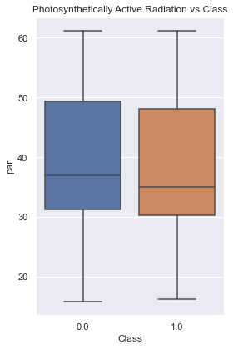
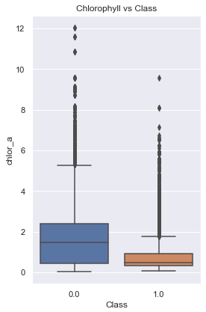
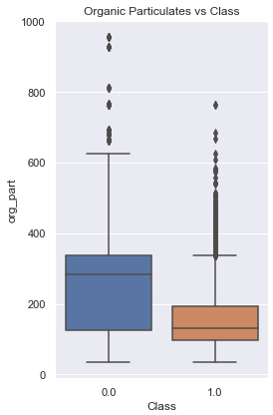
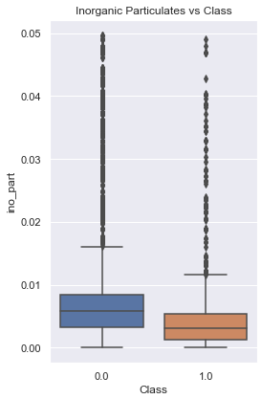
Giovanni Parameters vs Class
Legend
Non- Coral
Coral

Slide 27
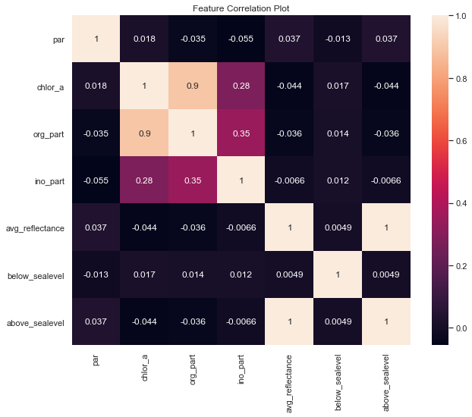
Correlation Plot
Strong correlation observed between Chlorophyll and Organic Particulates.
The average reflectance data from 300 Calipso features along with features below and above Sea Level show no correlation to other coral reef parameters.
No other significant correlations to note.
Notes:
kareem add comments

Slide 28
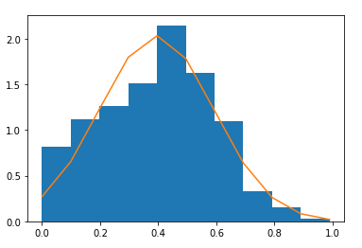

Dataset Breakdown: Fused Dataset - Confidence Estimation
Confidence was calculated using the distance from the Allen Coral Atlas, DHW, and Giovanni observations to the closest CALIPSO reflectance measurement
Data was first filtered to give any value greater than 1500m a confidence of zero
The distance was used to estimate a KDE and then averaged between Allen Coral Atlas and DHW for a total confidence score
Many observations had high confidence (small distances between observations) for one data source but not the others
This methodology allowed us to quantify our uncertainty as we utilize the fused dataset
Histogram of Total Confidence Values

Slide 29
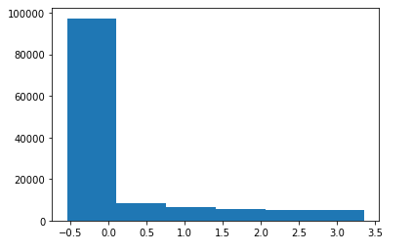
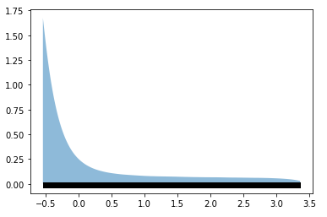
Dataset Breakdown: Fused Dataset - Confidence Estimation (ac_distances to ac_confidence)
The distance value is an automatic metric provided by GeoPandas when performing spatial joins on dataframes
The dataset was filtered to remove values above the threshold, scaled, and then a histogram was fit
Appears Exponential from the “eye” test
Tuned the parameters and kernels and ended up with the Kernel Density Estimation to the right
Histogram
Exponential KDE

Slide 30
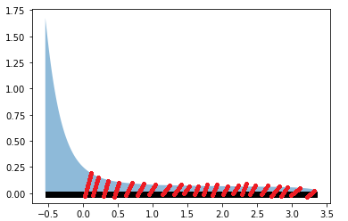
Dataset Breakdown: Fused Dataset - Confidence Estimation (ac_distances to ac_confidence)
Area under the curve for a KDE is equal to 1 and can be used to represent the probability of encountering certain values (or distances)
In our case, we estimated the integral using the KDE from the min observed value to every distance observation in the set
Then we took the complement to find the probability of encountering a value equal to or greater than the given distance - this value is our confidence
Representation of Confidence Calculation

Slide 31
Technical Area 3: Classifiers - Vitality Data
Primary data used is Allen Coral Atlas label - the team simplified 5 labels (Algae/Coral, Sand, Rock, Seagrass, Rubble) to “Coral” and “Other”
Coral is separated from Coral/Algae by using Reefbase and Florida Bleach Watch reports to confirm locations of reefs where Allen Coral Atlas has the Coral/Algae class
The variable “crw_baa_7d_max” is the primary identifier for coral health and whether bleaching is present at a given location and time
The team’s methodology is to generate coral/other labels, match this to the coral vitality data to determine coral health at that location and time, and then visualize the results to enhance inference

Slide 32
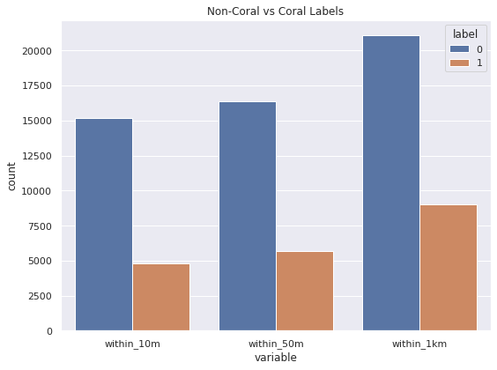
Class Distributions
The Coral vs Non-Coral label count on the left show a significant imbalance in classes for various Calipso distances to the label.
Two approaches to addressing class imbalance for modeling:
Oversampling using SMOTE:
SMOTE is Synthetic Minority Oversampling Technique that synthesizes new examples from minority class.
May lead to overfitting the data.
Random Undersampling:
Remove samples from majority class (non-coral labels).
Potentially remove meaningful data points.

Slide 33
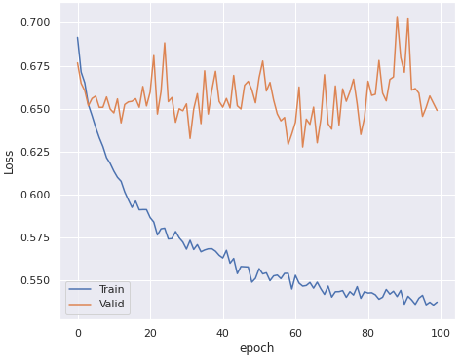
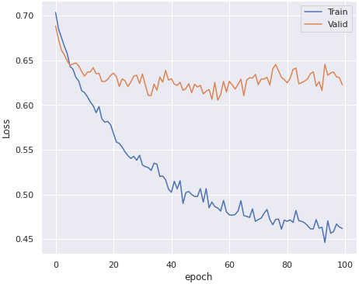
Sampling Methods: Oversampling vs Undersampling
Oversampling using SMOTE Loss Curve
Random Undersampling Loss Curve
The loss curves above were plotted after fitting a feed-forward network DNN model using SMOTE for over-sampling and random undersampling. The validation loss curve shows unstable convergence and potential signs of overfitting compared to random undersampling → choose random undersampling method in evaluation.

Slide 34
Technical Area 3: Correlate Imagery Backscatter with Coral Vitality
Goal: Use neural network inference (based on CALIPSO imagery) to demonstrate that we can predict the existence of coral in an observed region. Use inference to confirm that we can predict properties of vitality in an observed region.
Model | Parameters | Accuracy | Why this Model is Applicable
One-Dimensional Convolutional Neural Network (1D CNN) | Dropout rate as 0.3 Adam as optimizer and binary cross entropy as loss function. Set batch_size as 16, epochs as 100 and 20% for validation set Kernel size of 5 50m distance threshold for Allen Coral Atlas Filtering | 75.38% | CNN works well with classification problem involving spatial relationship and sequential relationships Applications using 1D CNN structure include sensors.
Feed Forward Neural Network | Dropout rate as 0.5 Adam as optimizer and cross entropy as loss function. Set batch_size as 500, epochs as 100 and 20% for validation set 50m distance threshold for Allen Coral Atlas Filtering | 72.85% | Feed Forward NN works well with high dimensional data classification problem.
Notes:
update for kareem and andy’s models - Andy

Slide 35
Technical Area 4: Model and Data Tuning
We wanted to to see if we could improve on our top performing accuracy of 75.38%
The team identified 2 major areas where we thought we could enhance performance
Only implement features which show a statistical difference between classes for CALIPSO reflectance data
Augment the training data with the 4 Giovanni parameters: Photosynthetically Available Radiation (PAR), Chlorohphyll A, Organic Particulate, and Inorganic Particulate
Parameters | Distance from Labels | Hypothesis
Calipso | 10 m 50 m 1 km | Models will perform better for larger distances from Labels. Models using Calipso + Giovanni parameters will perform best.
Calipso using Feature Selection
Calipso + Giovanni
Notes:
Quinn -

Slide 36
Technical Area 4: Feature Selection
As previously identified, there were certain altitudes that aligned with specific features where we believed there may be statistical differences in the data
Using those features (0-10, 205-210 and 220-225), the team hoped to improve results
Unfortunately the opposite was true and accuracy decreased by almost a flat 10% across all models
For the 23 identified features with 84,118 observations each, there were 988, 505 (~51%) negative values
Across the whole dataset (300 features with 84,118 observations) there are 12,856,830 (~51%) negative values
By removing the majority of the features, the team believes we also removed a huge amount of “good” data and allowed the noise to play a more significant role in confounding our models

Slide 37
Technical Area 4: Combining the Two Approaches
Lastly, the team decided to see if combining the two approaches and adding Giovanni data to a filtered CALIPSO model would lead to any significant insights
As expected, the models improved slightly in performance but less than previously observed with all 300 CALIPSO features
Overall, the addition of new data did improve model performance by roughly 5%, but the team had to directly go against the direction of the NASA team and apply data outside the CALIPSO dataset

Slide 38
Technical Area 4: Interpret Trends in a Known Global Region based on Backscatter Alone
Models at a distance filter of 10m:
Model | Full Model Accuracy | 23 Features Accuracy | Full + Giovanni | 23 Features + GIovanni | Notes
Feed Forward Neural Network | 68.63 | 65.51 | 76.16 | N/A | Across all models and methods, the best accuracy achieved is 77.67% Limitations on the CALIPSO reflectance data severely hurt model performance
1D CNN | 75.31 | 66.78 | N/A | N/A
Logistic Regression | 53.65 | 49.72 | 66.27 | 56.27
Random Forest | 60.75 | 58.55 | 69.17 | 66.68
Notes:
result is yellow as it might be our best model with being our “best:

Slide 39
Technical Area 4: Interpret Trends in a Known Global Region based on Backscatter Alone
Models at a distance filter of 50m:
Model | Full Model Accuracy | 23 Features Accuracy | Full + Giovanni | 23 Features + GIovanni | Notes
Feed Forward Neural Network | 72.85 | 66.40 | 74.82 | N/A | Across all models and methods, the best accuracy achieved is 77.67% Limitations on the CALIPSO reflectance data severely hurt model performance
1D CNN | 75.38 | 69.49 | N/A | N/A
Logistic Regression | 51.11 | 51.11 | 64.61 | 53.60
Random Forest | 59.88 | 58.07 | 69.41 | 68.94
Notes:
results for each model - Quinn

Slide 40
Technical Area 4: Interpret Trends in a Known Global Region based on Backscatter Alone
Models at a distance filter of 1000m:
Model | Full Model Accuracy | 23 Features Accuracy | Full + Giovanni | 23 Features + GIovanni | Notes
Feed Forward Neural Network | 73.14 | 68.65 | 77.67 | N/A | Across all models and methods, the best accuracy achieved is 77.67% Limitations on the CALIPSO reflectance data severely hurt model performance
1D CNN | 75.84 | 71.98 | N/A | N/A
Logistic Regression | 48.68 | 48.68 | 63.96 | 63.96
Random Forest | 61.74 | 51.97 | 68.88 | 65.22
Notes:
results for each model - Quinn

Slide 41
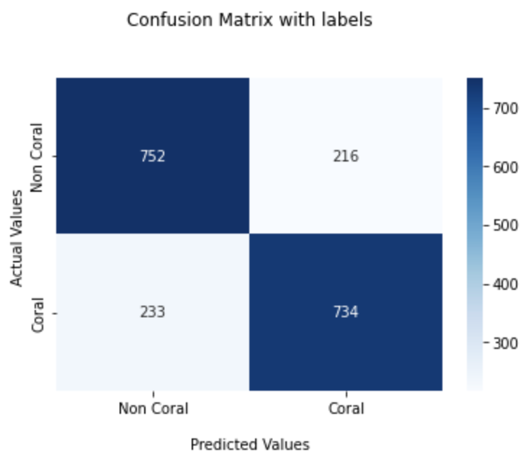
Technical Area 4: Best Models
Best Accuracy Overall:
77.67% - Feed Forward Neural Network with Full CALIPSO + Giovanni features with 1000m filter
Best Accuracy that meets the NASA Requirements (CALIPSO only):
75.84% - 1D CNN with Full CALIPSO and 1000m filter
Team’s Pick:
75.31% - 1D CNN with Full CALIPSO and 10m filter
The model loses ~2% accuracy to meet the NASA prompt compared to the best Accuracy model and enhance the distance threshold by 100x
The model loses 0.53% accuracy compared to the best NASA Model to decrease the distance threshold by 100x
This model achieves the goals of the NASA prompt while providing a tool that can inform the Coral Vita team of a coral location to within 10m of a given lat/lon point which seems to far outweigh the marginal gain in accuracy presented by the other 2 models
Team’s Pick Confusion Matrix
Notes:
andy confusion matrix

Slide 42
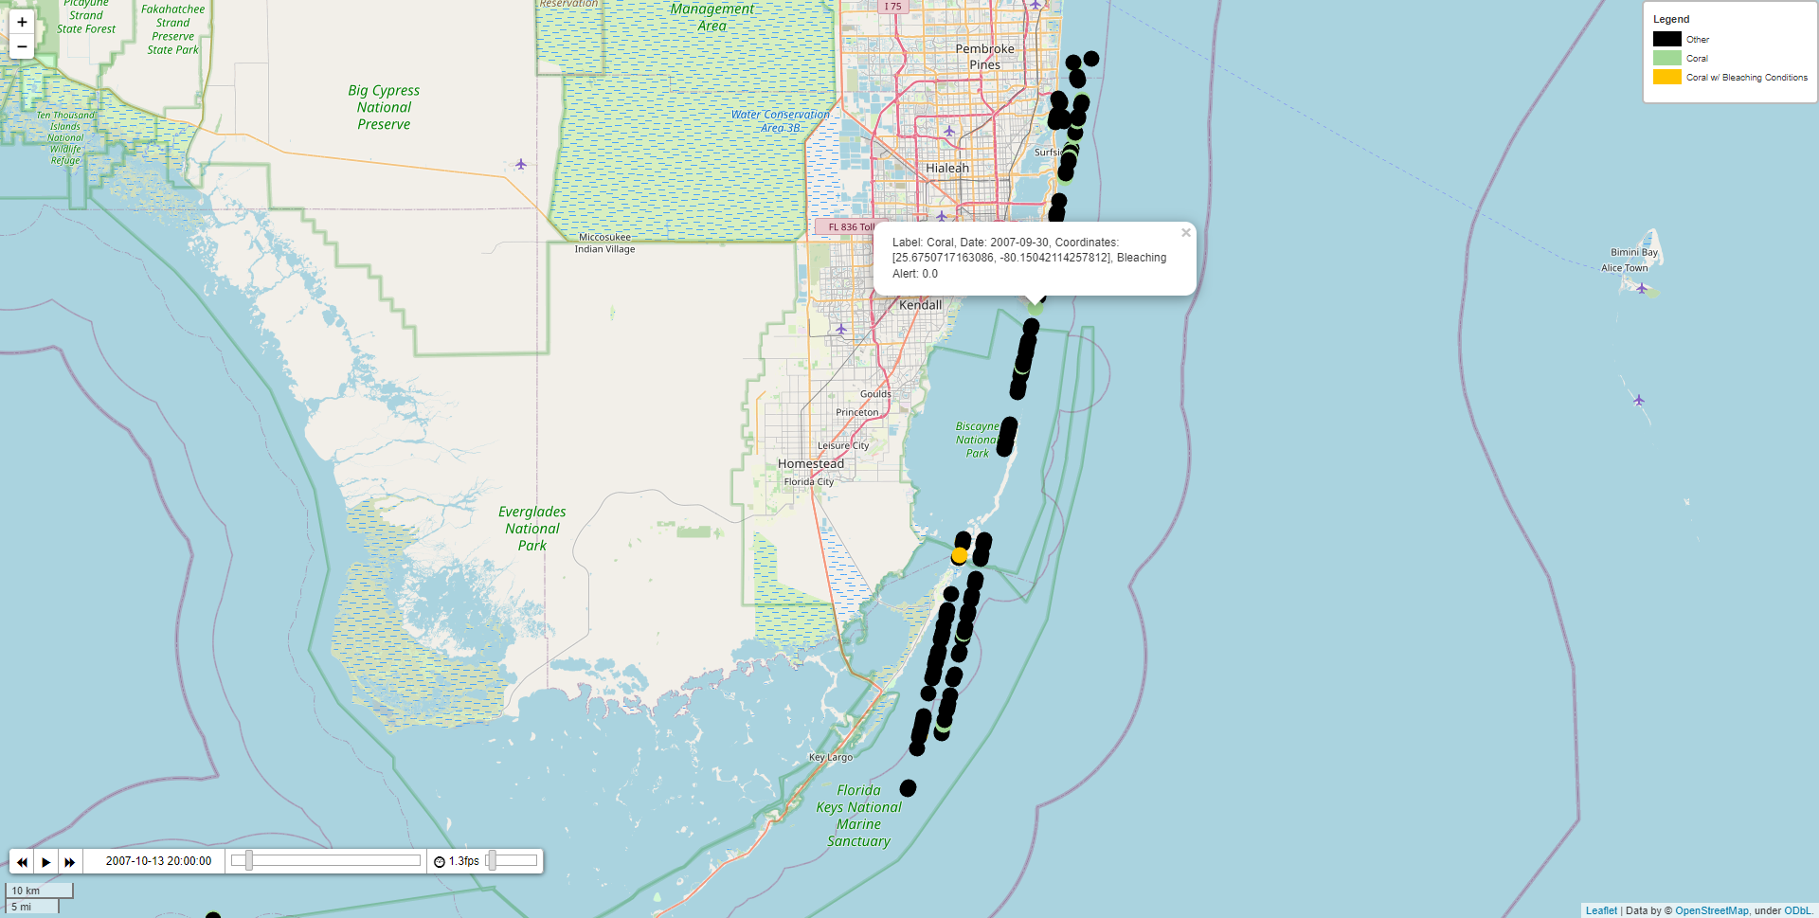
Technical Area 4: Data Visualization and Inference
Data labels are visualized on an interactive time-series plot of CALIPSO measurements
A user can interact with the chart to select dates and locations as needed

Slide 43
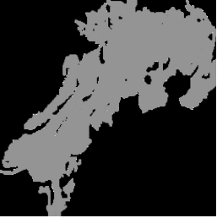
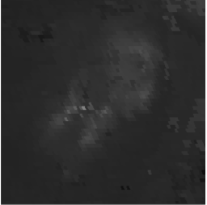
Technical Area 4: “Failed” Classifiers - U-net CNN
CALIPSO data was far too sparse to apply to a U-net CNN where we require labels for every pixel in an image to train a classifier
The team found that MODIS-Aqua might be used with Allen Coral Atlas to train a U-net model but did not go deep down this path based off feedback from the NASA team
While the team was unable to get a fully functioning model, the data does appear promising for future work
Greyscale Allen Coral Atlas mask used for labeling in U-net
Greyscale MODIS-Aqua data

Slide 44
Technical Area 4: Takeaways and Future Work
From our efforts, we can learn:
Creating a fused dataset of open-source coral reef data is feasible
With CALIPSO reflectance data alone, it is difficult to accurately predict locations of coral
Using numerous different models, the best accuracy on the test data was 77.67%
Reasons for poor performance:
Little separation between reflectance values for each class
Sparse dataset due to satellite ground track and orbit (low confidence of ~39% when data is present)
Inherent errors in the data adds large amounts of noise
Recommendations for the future:
Combine our Fused Dataset with other available imagery (Sentinel or MODIS) and implement new models such as U-net CNN
Further research the use of data such as Giovanni to augment CALIPSO data
Explore filtering the dataset by confidence level rather than distance

Slide 45
Questions?

